Slide 2
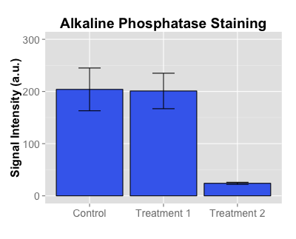
p=0.02
ns
p=0.01

